Slide 1


Privacy Masked Federated Learning for Heart Disease Diagnosis
Major Project Phase - I (Group ID: 50)
ABHISHEK R (1JS23CS004) CHETAN KISHOR C G (1JS23CS032) HONGIRAN D (1JS23CS062) THIRUMANGAI S (1JS23CS180)
Guide: Dr. Rajeshwari K S Department of Computer Science and Engineering JSS Academy of Technical Education, Bengaluru
May 8, 2026
Privacy Masked FL

Slide 2
Problem Overview
Centralized Data Risks: Traditional AI models store sensitive patient data (ECG, lab reports) on central servers, leading to privacy vulnerabilities.
Data Leakage: Accidental exposure of confidential medical records through generative AI and online tools.
Black-box Models: Lack of transparency and actionable explanations in current heart disease diagnosis systems.
Fragmented Data: Multimodal information (ECG + Clinical Text + Lifestyle) is often not utilized together.
Privacy Masked FL

Slide 3
Proposed Solution
A secure and intelligent framework integrating:
Federated Learning (FL): Distributed training where raw data remains local; only model updates are shared.
Privacy Masking: NER-based removal of sensitive PII (Name, ID, Address) from clinical reports.
Multimodal Fusion: Combining ECG (BiLSTM/Transformers), Clinical Reports (Transformers), and Lifestyle data (TabTransformer).
Explainability: Counterfactual insights and causal reasoning for trustworthiness.
Privacy Masked FL

Slide 4
Project Objectives
Develop an AI-based system for secure heart disease diagnosis. Implement Federated Learning for privacy-preserving model training.
Apply NER techniques for automatic privacy masking of patient reports.
Process multimodal data (ECG, clinical reports, lifestyle) for higher accuracy.
Provide explainable predictions using counterfactual reasoning. Build an interactive dashboard for doctors and patients.
1
2
3
4
5
6
Privacy Masked FL

Slide 5
Literature Survey & Gaps
Gap 1: Most systems prioritize accuracy over patient privacy.
Gap 2: Absence of multimodal fusion (textual reports are rarely combined with ECG).
Gap 3: Lack of distributed learning (most systems are centralized).
Gap 4: Limited interpretability (black-box predictions without "why" or "what-if").
Our Improvement
Unified framework addressing Privacy + FL + Multimodal + XAI.
Privacy Masked FL

Slide 6
Proposed Methodology
Input (ECG, Reports, Lifestyle)
Privacy Layer (NER Masking)
Feature Extraction (BiLSTM/Transformer)
Multimodal Fusion (Graph Neural Networks)
Federated Learning (Flower Framework)
Output (Risk Score + Explanations)
Privacy Masked FL

Slide 7
System Architecture
Privacy Layer: Local processing to mask PII using spaCy/BERT.
Feature Extraction: Multimodal processing via BiLSTM and Transformers.
Multimodal Fusion Layer: Integrating features using Graph Neural Networks (GNN).
Federated Learning Layer: Distributed training using the Flower framework.
Explainability Layer: Counterfactual insights and Causal AI (DoWhy).
Privacy Masked FL

Slide 8
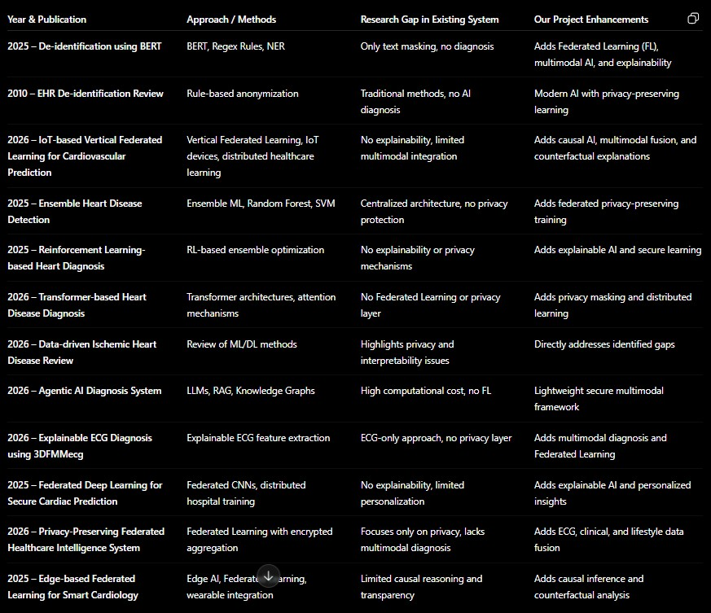
Literature Survey Comparison
Privacy Masked FL

Slide 9
Technologies & Tools
AI & Privacy:
PyTorch / TensorFlow Flower (FL)
spaCy / BERT (NER) DiCE / DoWhy (XAI)
Web & Data:
Python / FastAPI React.js / Tailwind CSS MongoDB / MySQL Plotly / Streamlit
Privacy Masked FL

Slide 10
Conclusion & Future Work
Summary: Successfully integrated Federated Learning with Privacy Masking for a secure cardiac diagnostic system.
Impact: Addresses critical gaps in healthcare AI privacy and explainability.
Future Enhancements:
Real-time wearable device integration. Blockchain-based security for model updates.
Advanced Homomorphic Encryption for ultra-secure training.
Privacy Masked FL

Slide 11
Thank You!
Privacy Masked FL

